Slide 1
Requirements To Proceed
Energy Giant LLC’s “No Pollution Energy Solution” Program
Phase One: LNG Regas/Storage Facility
Phase Two: CCGT Power Plant
Phase Three: MED Desalination Plant
Phase Four: Greenhouse Export Facility
Phase Five: Local Coal Beneficiation to Diesel Facility

Slide 2
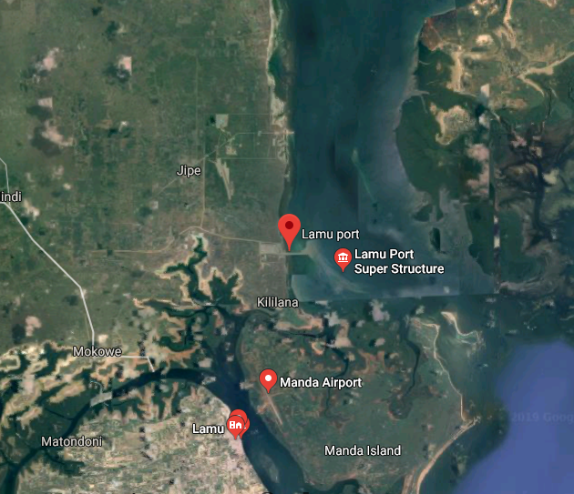
License to Import LNG
Organization:
License to Store & Regasify LNG
Organization:
Build & Operate Berth to Receive LNG
Kenya Port Authority
Build & Operate LNG Storage/Regas Facility
Kenya Port Authority
License / Right of Way for CNG Pipeline to Power Plant
Organization:
License / Right of Way for CNG Pipeline to Local Coal Beneficiation Facility
Organization:

Slide 3
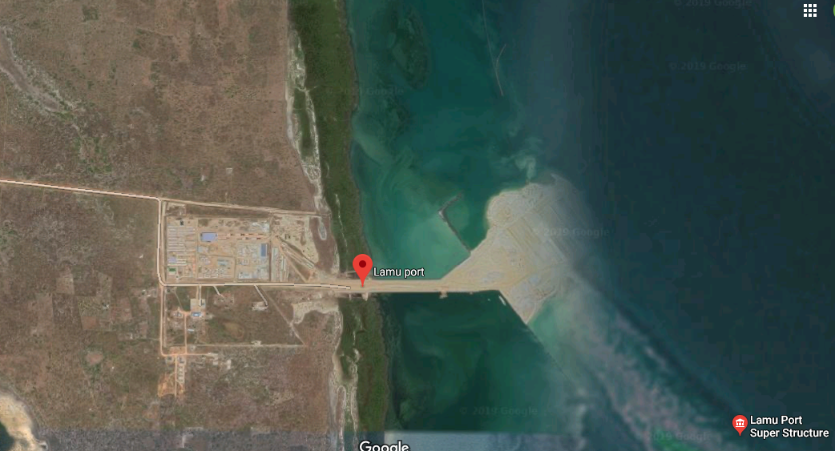
CDTS Storage of LNG; Regasification Sled
LNG Pipeline
Panamax Carrier Berth built to receive LNG

Slide 4
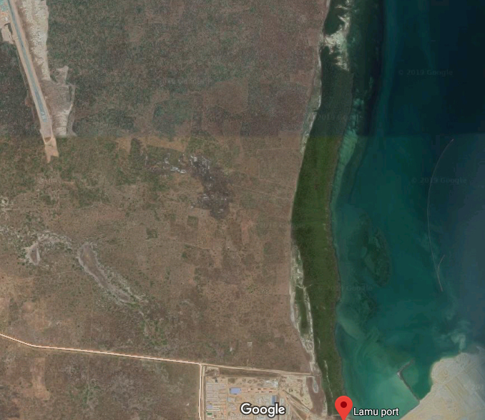
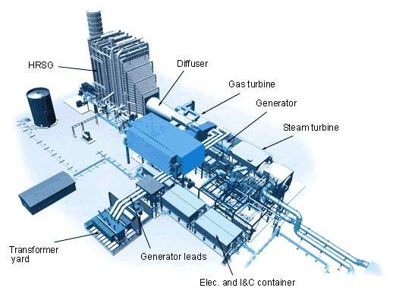
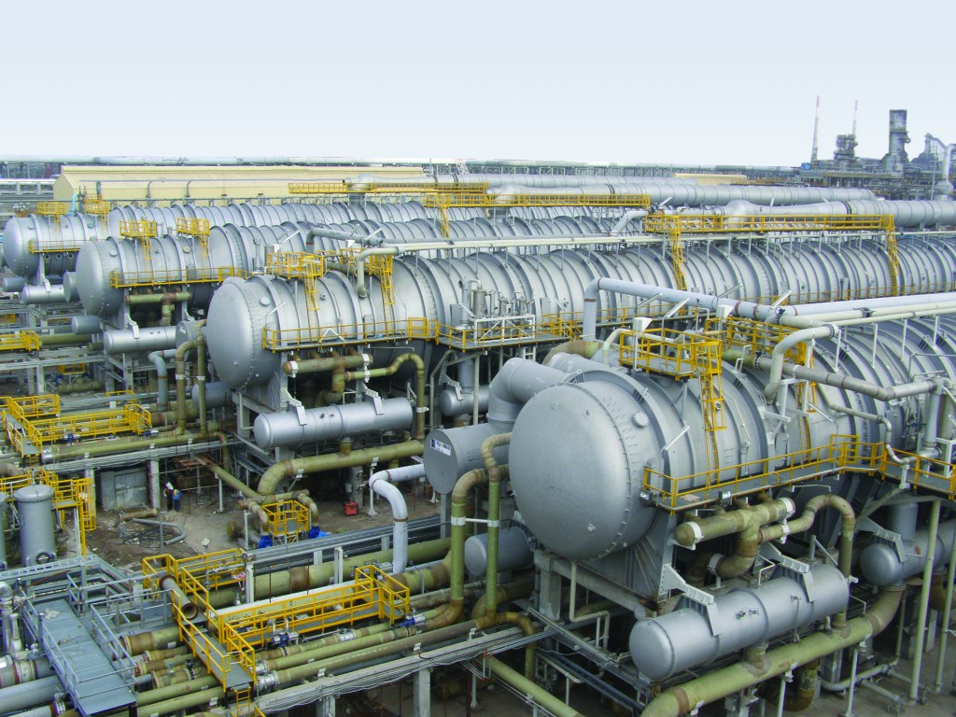
Landowners Become JV Partners in These Facilities
3-1 Gas Turbine Power Platform
Low-Heat
Desal Plant
3-1 Gas Turbine Power Platform
Low-Heat
Desal Plant
3-1 Gas Turbine Power Platform
Low-Heat
Desal Plant
3-1 Gas Turbine Power Platform
Low-Heat
Desal Plant
CDTS Storage of LNG;
Regasification Sled

Slide 5
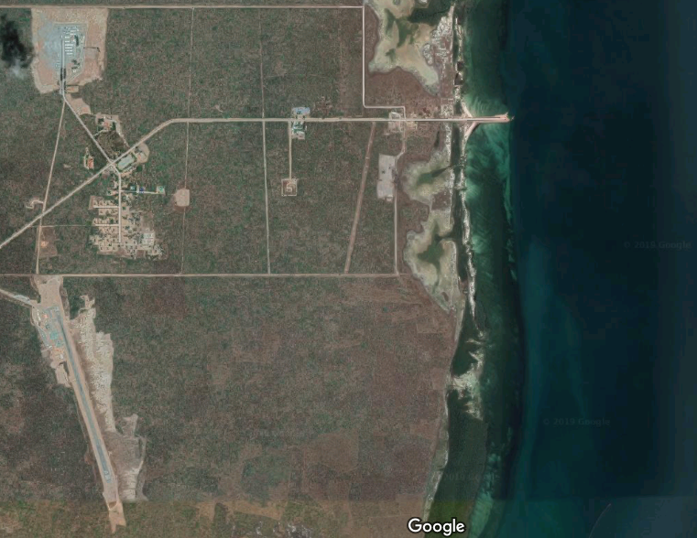
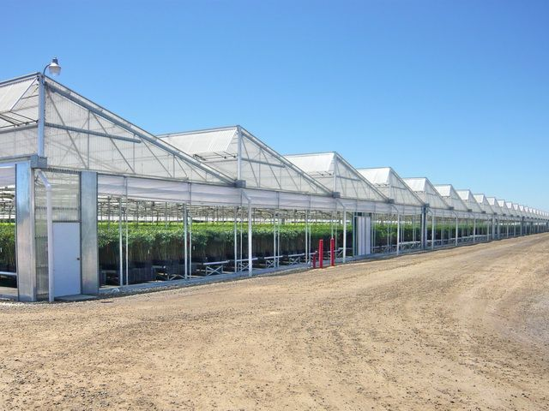
Landowners Become JV Partners in These Facilities
CO₂-Fed Export Greenhouse
CO₂-Fed Export Greenhouse
CO₂-Fed Export Greenhouse
CO₂-Fed Export Greenhouse
CO₂-Fed Export Greenhouse
CO₂-Fed Export Greenhouse
3-1 Gas Turbine Power Platform
Low-Heat
Desal Plant

Slide 6
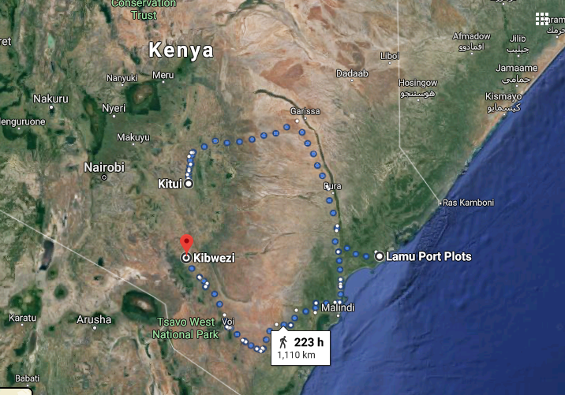
Right of Way for Transmission of 400 MW of constant power from Lamu Port power plant to Kitui
Build dedicated transmission line about 220 mi (350 km) -- Lamu Port power plant to Kitui coal fields.
Right of Way for CNG of 200mmscfd pipeline
Build dedicated 200mmscfd CNG pipeline — Lamu Port to Kitui coal fields.
Right of way for diesel pipeline from Kitui to Kibwezi diesel receiving facility
Build dedicated diesel pipeline from Kitui to Kibwezi where we sell diesel certified as EURO VI from our receiving facility built there

Slide 7
Direct Sales Agreements
The National Bank of Kenya, or an alternative bank, could introduce us to Heavy Industrial Users with whom we can negotiate bulk electricity sales agreements that could save them significant cost
The National Bank of Kenya, or an alternative bank, could introduce us to high-value water distributors with whom we can negotiate wholesale bottled-water agreements for distribution to upscale retailing sites.
The National Bank of Kenya, or an alternative bank, could introduce us to common water distributors with whom we can negotiate bulk common water agreements for distribution to the general populace.
The National Bank of Kenya, or an alternative bank, could introduce us to the export freight forwarding companies that now fly out flowers to Europe daily with whom we can negotiate forwarding agreements for our export crops from our industrial greenhouses.

