Slide 1
Resilient Power in Developing Countries
G.R. Langworth
For
Energy Giant LLC HKSAR

Slide 2
Custom-Tailored Power Solution
We have developed a versatile engineering capability in Morocco to purchase, integrate, install, and operate modular power plants
These modular power plants are standardized on the Siemens 321.9 MW SGT A65 WLE ISI 3 on 1 One Pressure Fired combined cycle system
All engineers are trained and certified at Siemens [https://www.energy.siemens.com/co/pool/hq/services/market-specific-solutions/Training/siemens-plant-operations-support.pdf]
We will purchase standardized 321.9 MW power modules based on the SGT A65 WLE ISI from Siemens, implement them in Morocco, then pack them up and ship them to our developing country client sites where we will install, operate and maintain them.
As the power requirements inevitably expand, we will continue to purchase and implement additional Siemens 321.9 MW power modules at our developing country client sites.
All power plants will be configured similarly to assure singular expertise, availability of spares and parts, and the highest efficiency of operation.
All 321.9 MW power modules can be trucked into the interior of a developing country client from the port of access. Right-sized component handling equipment will be a standard feature of each configuration. We will bring everything with us that we will need to build, operate, and maintain our power plant modules.
With our proprietary technology we will be extending the capacity up to 30% utilizing the existing equipment configuration.
We will supply all funding, and will contract for a service charge per kWh of electricity generated. The natural gas fuel will remain the responsibility of the power purchasing utility.
To date, we have been requested to build a 1,000 MW site in Tartus, Syria for a 3rd party, in addition to a 900 MW site in Tete, Mozambique, and a 650 MW site in Sri Lanka for our sister companies, ITTD, and MTTD respectively.

Slide 3
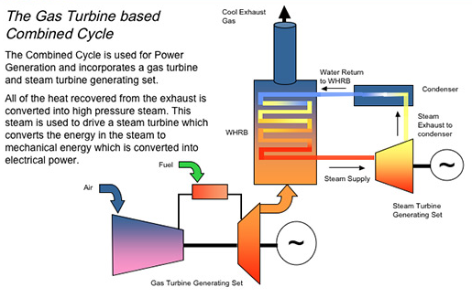
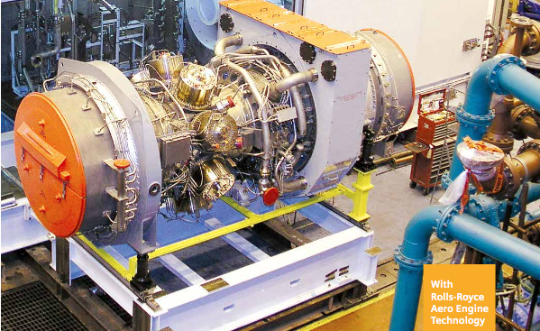
High power and efficiency: Due to an independent 3 shaft design, this turbine is flexible, offering high power out and fuel efficiency with minimal drop-off at reduced speed conditions
For power generation: One of the most efficient gas turbines on the market, the SGT-A65 provides up to 71 MW in simple cycle service at 43.8% efficiency
Modular design for quick installation and easy on-site maintenance: The SGT-A65 consists of 8 engine modules for easy maintenance. Each module is pre-balanced to make it completely interchangeable.

Slide 5
