Slide 1
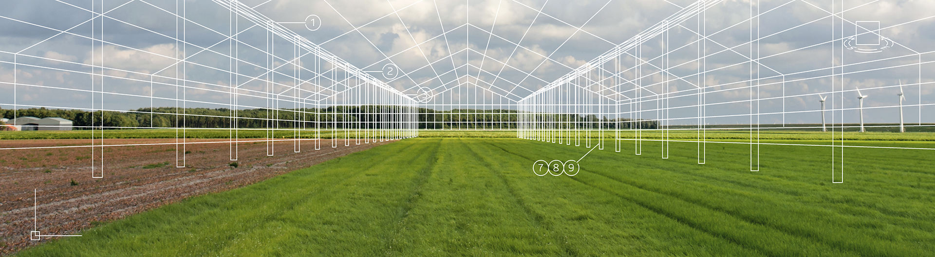
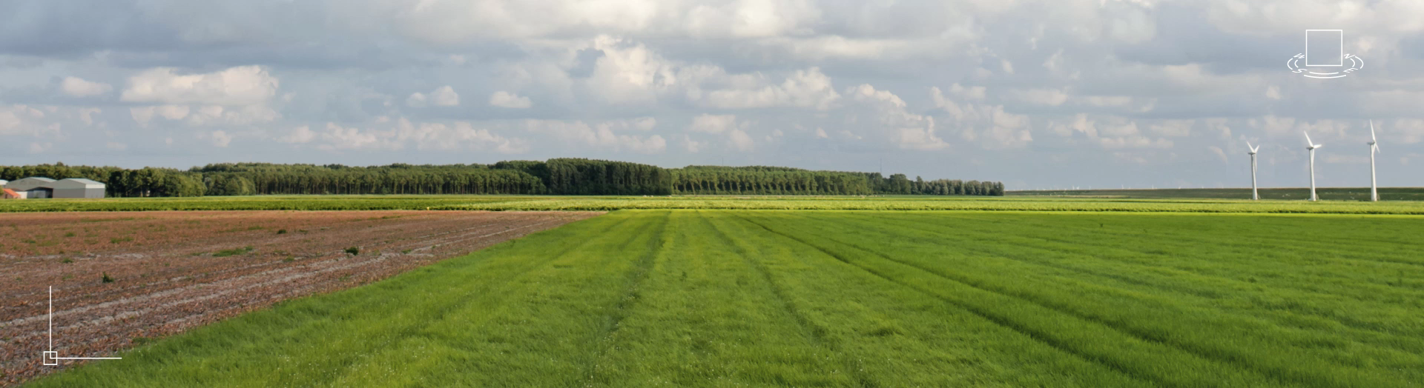
Introduction to
Bosman Van Zaal
March 2019

Slide 2


From your vision
To our solution

Slide 3
1
Who we are

Slide 4
Corporate story
Increasingly, the world requires smarter and more sustainable solutions for its plant production systems.
As the global population moves towards 9.7 billion (2050), innovative ideas are more necessary than ever before.

Slide 5
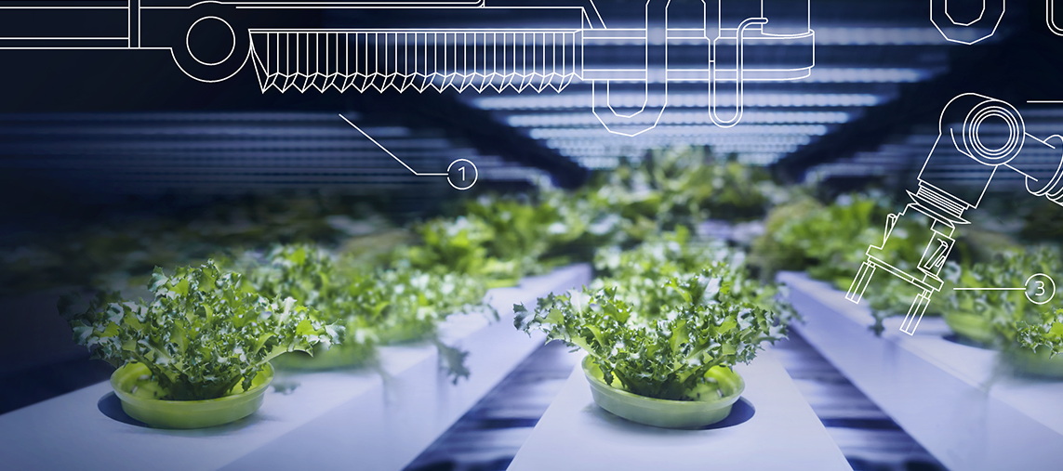
Corporate story
For nearly a century, Bosman Van Zaal has been designing and building greenhouses for global growers from our headquarters in the Netherlands.
Over the years we have acquired the vast network, knowledge and know-how to solve the agricultural and horticultural industry’s most complex challenges.

Slide 6
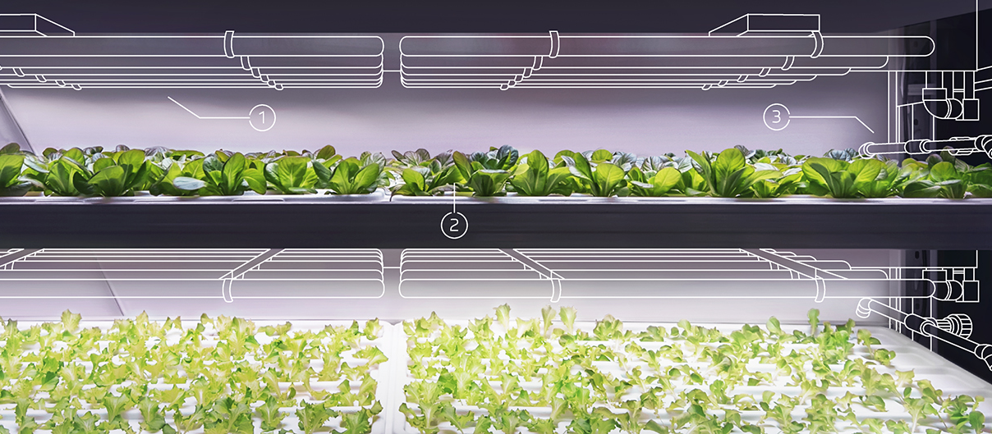
Corporate story
As a committed partner to leading global multinationals and research universities, we help the innovators innovate.
From food to cosmetics, pharmaceuticals to medicine, we create the solutions and systems needed to make our partners successful.

Slide 7
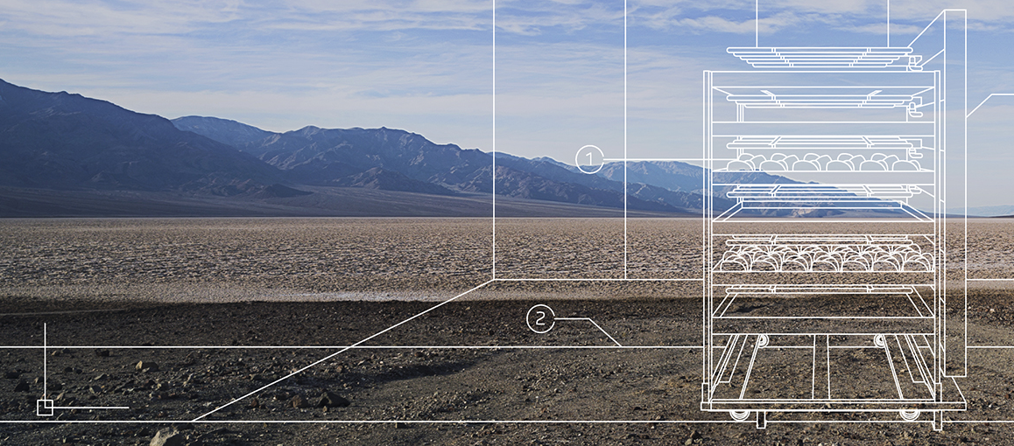
Corporate story
Whether building greenhouse facilities in Poland or Rwanda or designing integrated software systems in America or Australia. We bring to every project an inventive mindset backed by the industry’s widest range of in-house production and engineering disciplines. Open and collaborative, we have the scale to deliver tailor-made facilities and solutions quickly and confidently virtually anywhere.

Slide 8
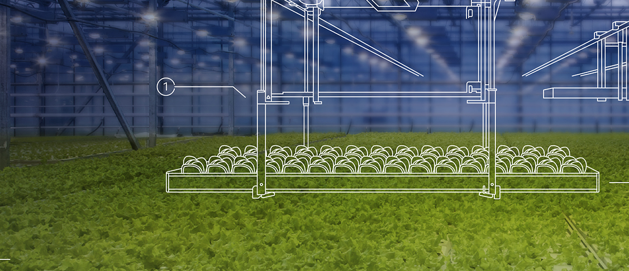
Corporate story
As the need for agricultural and horticultural products continues to grow, so will the need for innovation.
And that’s where we come in.
We offer solutions for long-term growth.

Slide 9


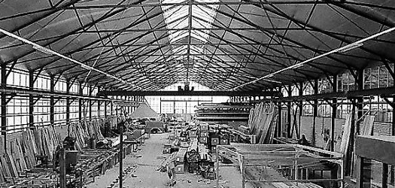
Our history
Our history begins in 1921 with the establishment of Bosman Greenhouse Building in Aalsmeer, where robust glasshouse constructions made of wood, steel and aluminium are developed. In 1968, Frans van Zaal started producing heating and cultivation systems in a small barn around the corner.
Our success gives us the opportunity to provide one of the most important growers in America with growing systems based on roller tables. This offers an opportunity to expand worldwide.

Slide 10
Our history
After a merger in 1988, we expand our expertise with water and electricity. Because of our growing ambitions, Green Innovators B.V. is founded in 2006 in order to build a professional company structure. Green Innovators acts as shareholder of a diverse group of companies. Crea-Tech is added in 2008.
And in 2014, after years of close cooperation, Bosman International and Montera Techniek are acquired. The trade name Bosman Van Zaal is a fact.

Slide 11
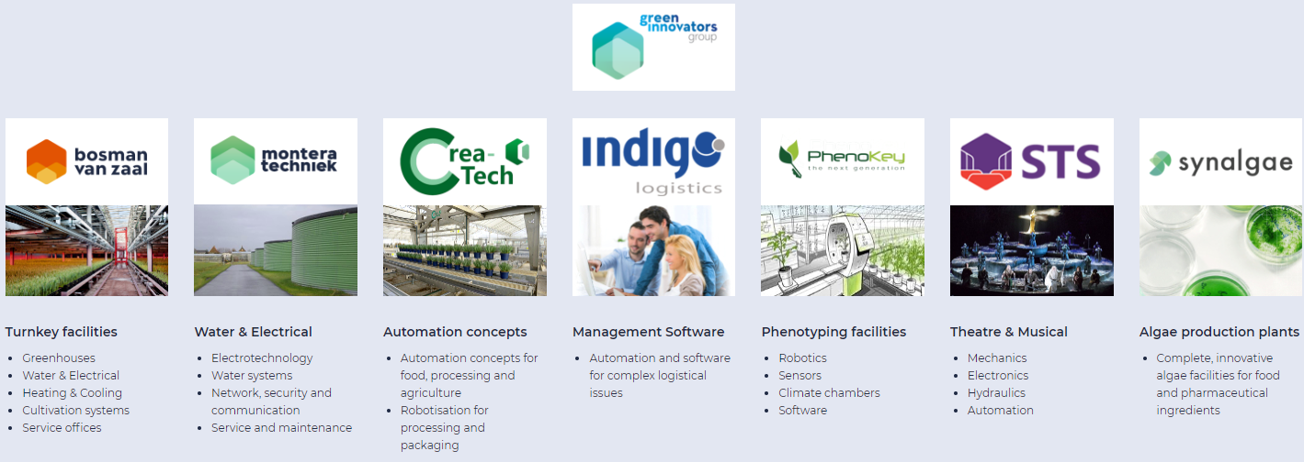
We do this together

Slide 12
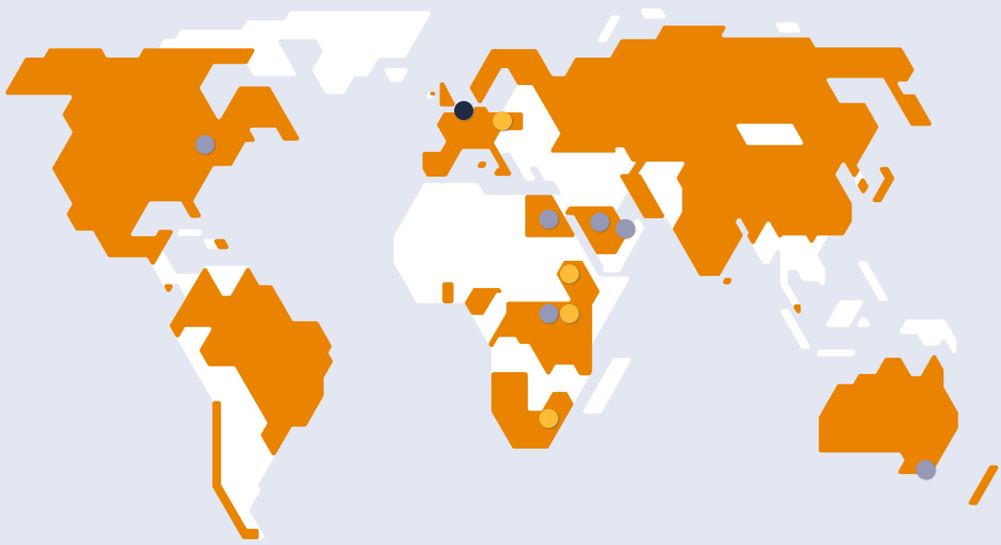
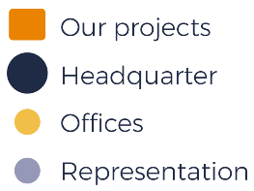
By now, we deliver turnkey facilities for horticulture worldwide

Slide 13
2
How we work

Slide 14


From your vision
To our solution

Slide 15
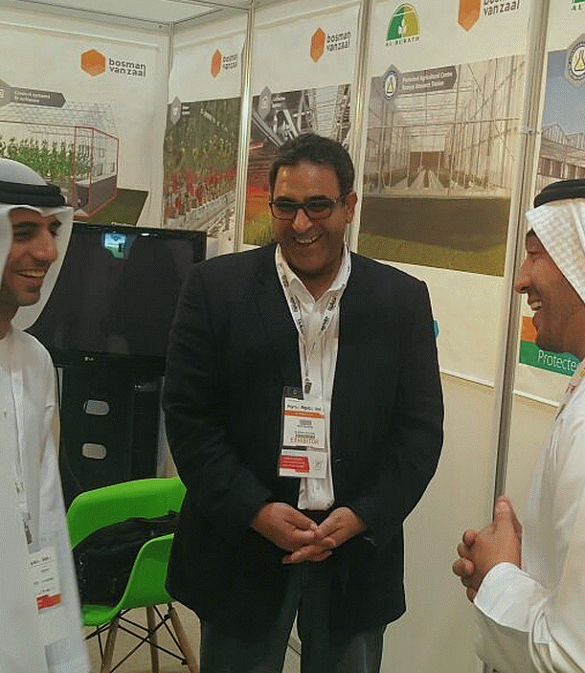
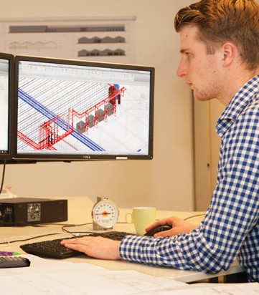
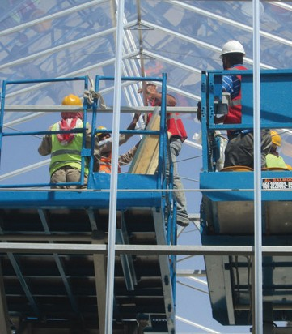
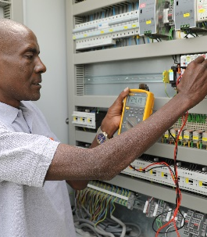
Our horizon process
Vision
Solution
Define
We are easily accessible both physically and digitally and meet innovative customers at trade fairs or (project) locations. We share our ideas and consult with you about your vision.
Engineer
We translate your vision into an inventive and smart design. This is our core competency and is performed as a team performance in which you, our client, are closely involved.
Realise
We transform the design into reality with our in-house production. We deliver the tailor-made facilities and solutions quickly and professionally virtually anywhere.
Service
We install and test the installation before we deliver the project, offer practical training and instruction on site and provide 24/7 support. Either remotely or on site.

Slide 16
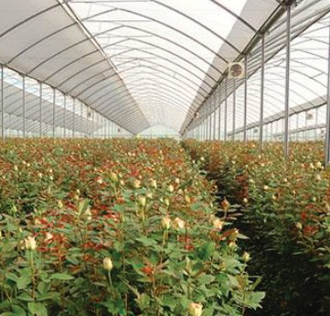
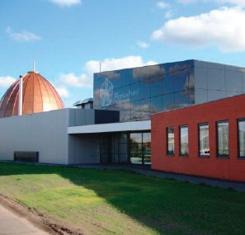
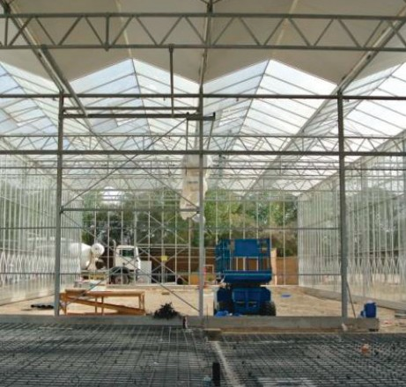
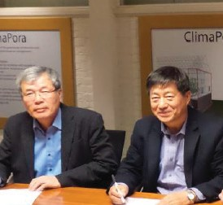
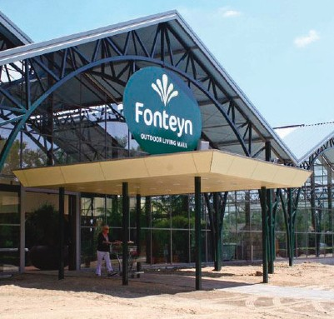
Our clients
Growers
Propagators
Crop Science
Investors & Corporate
Technical Companies
Professional nurseries worldwide.
Supplier of raw material, breeders/propagators.
Research facilities, experimental projects and authorities.
Investors and large multinationals/
corporate companies.
Companies that purchase materials for their own activities.

Slide 17
3
Our projects

Slide 18
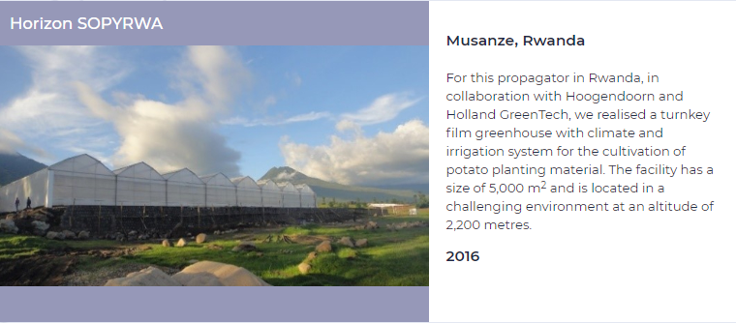
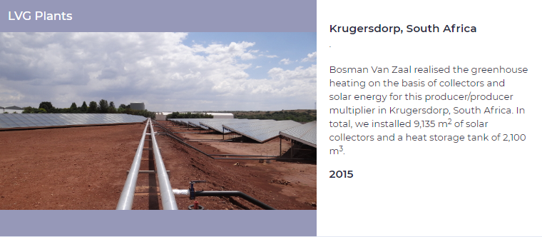

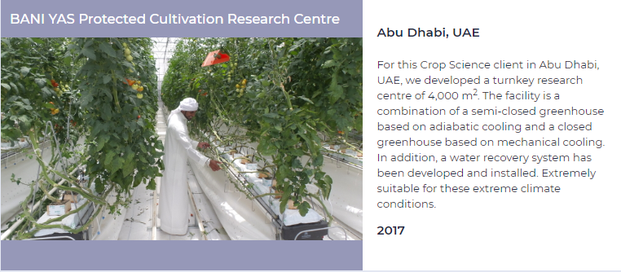
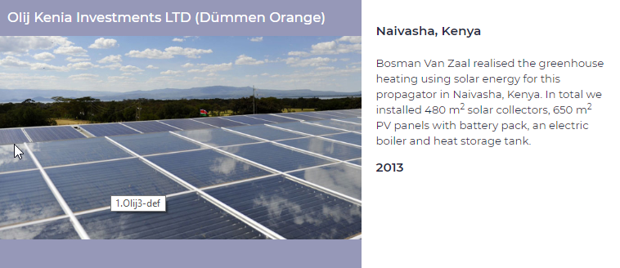
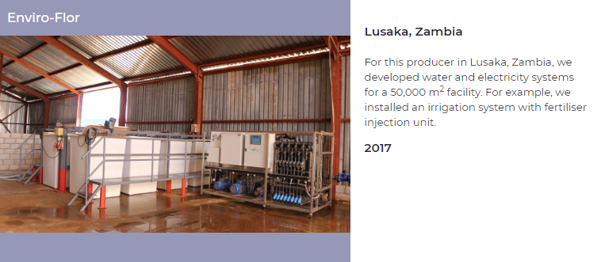
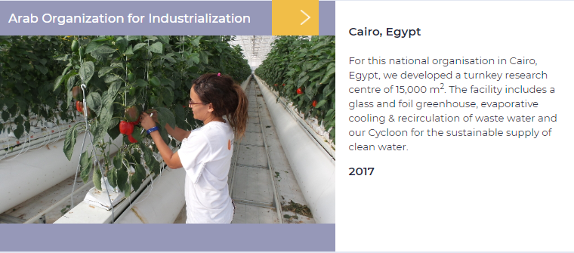
Some of our Africa projects

Slide 19
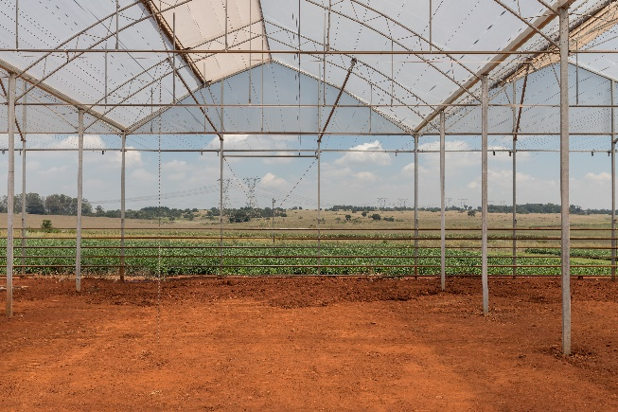
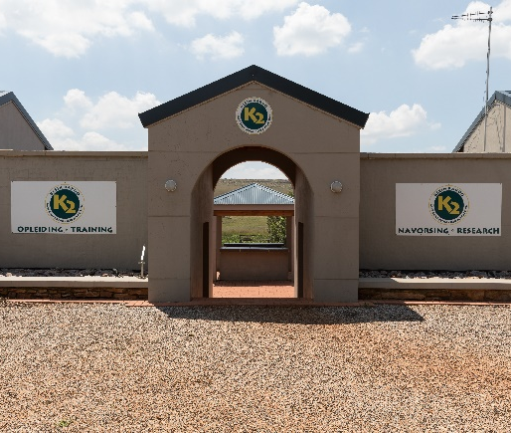
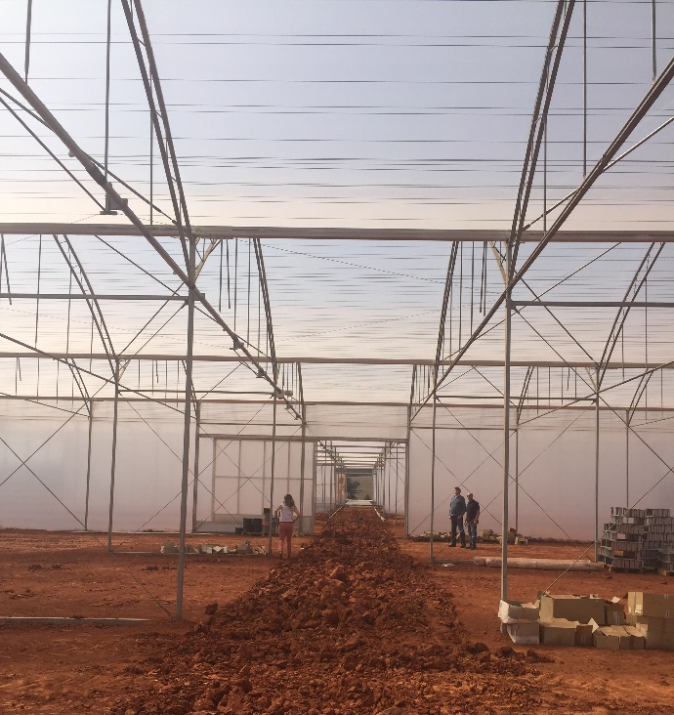
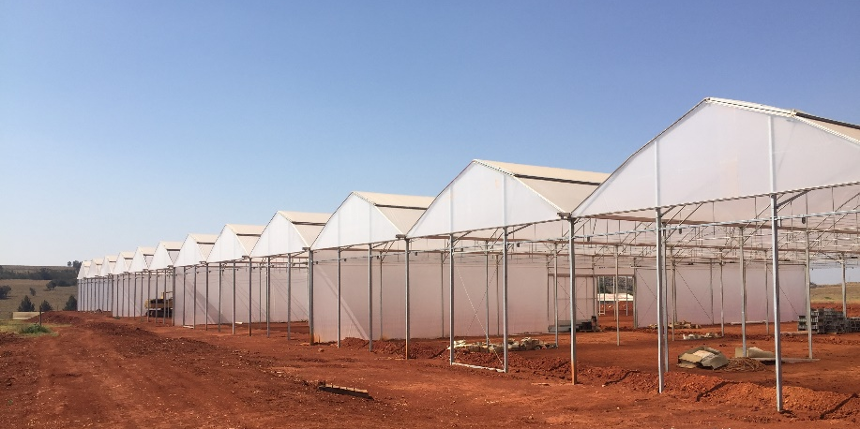
1 ha breeding station, South Africa, Johannesburg
turn-key project, film covered greenhouse

Slide 20
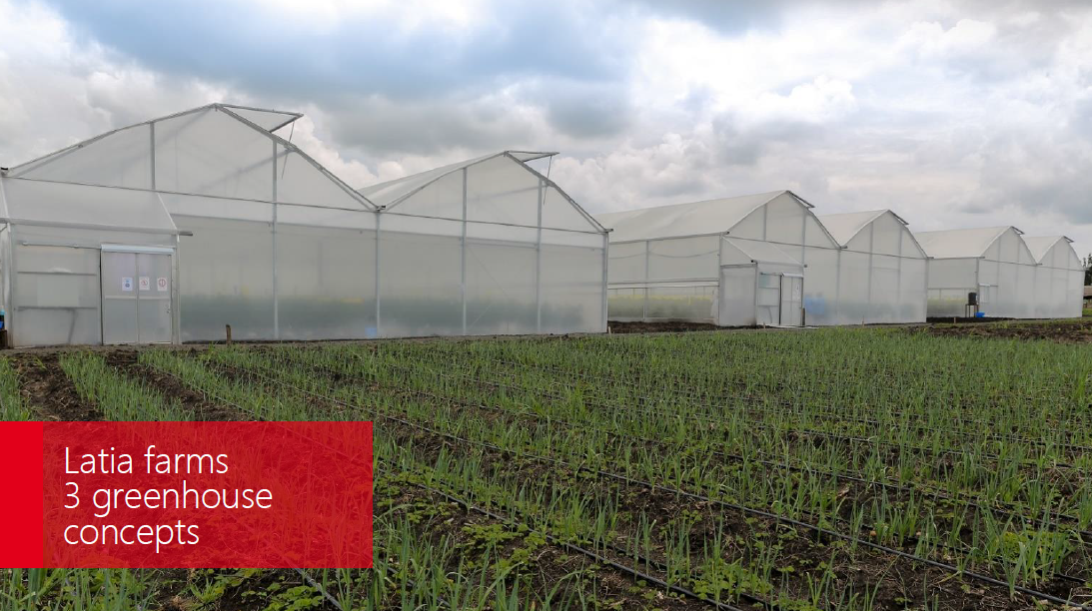
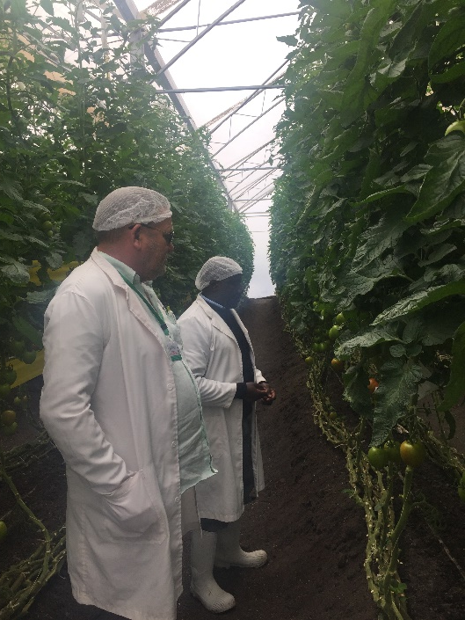
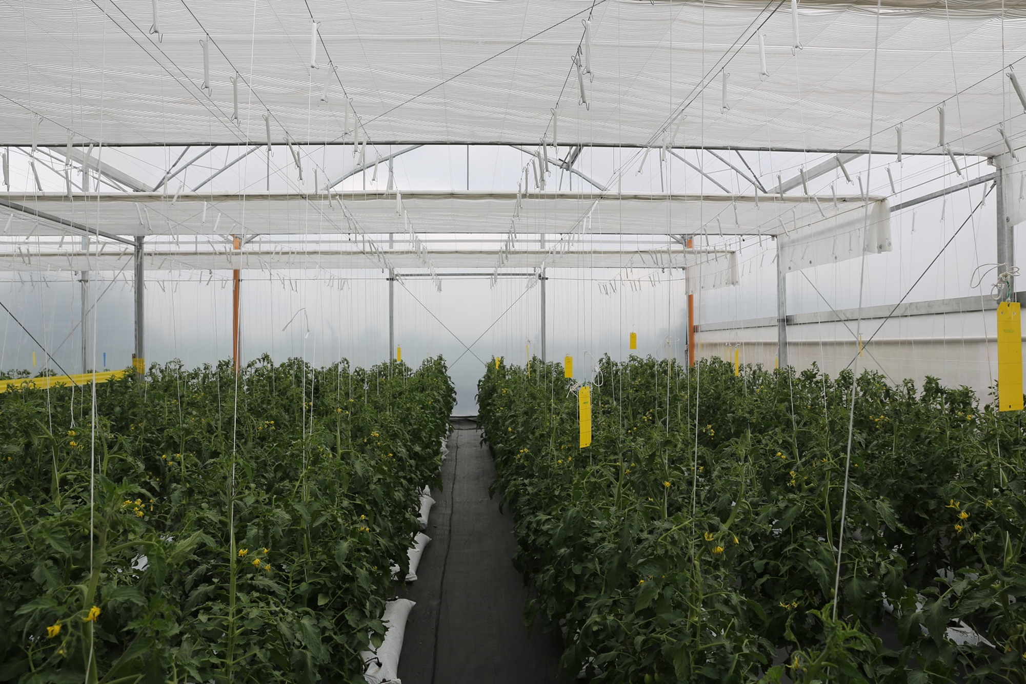
Latia Resource & Training Centre, Isinya, Kenya
3 x’s different technology level high wire vegetable project

Slide 21
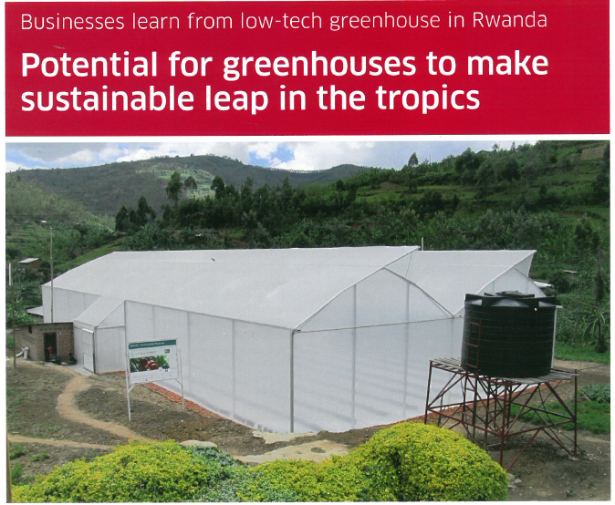
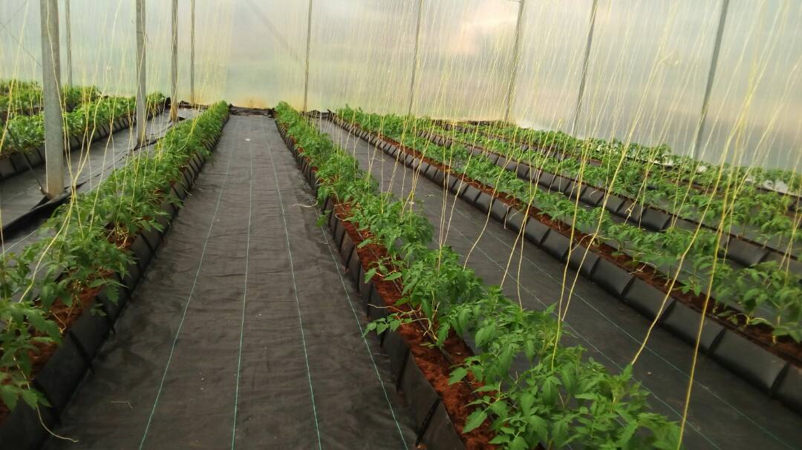
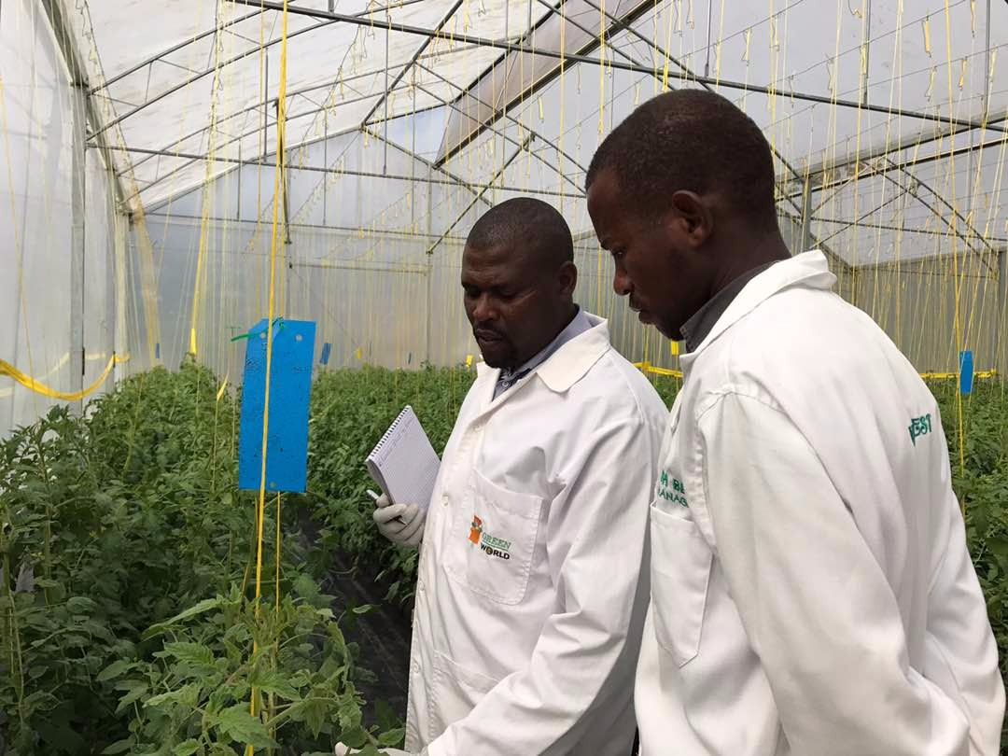
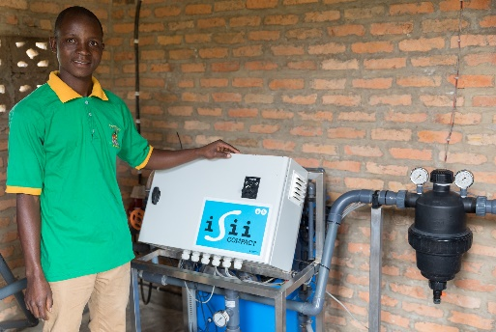
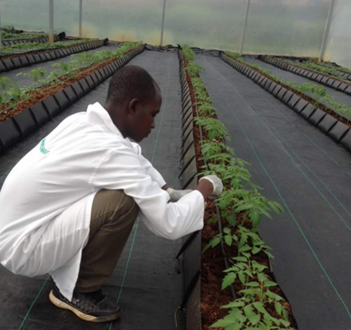
Rwanda Best Training Centre, Rwanda
High wire vegetable project

Slide 22
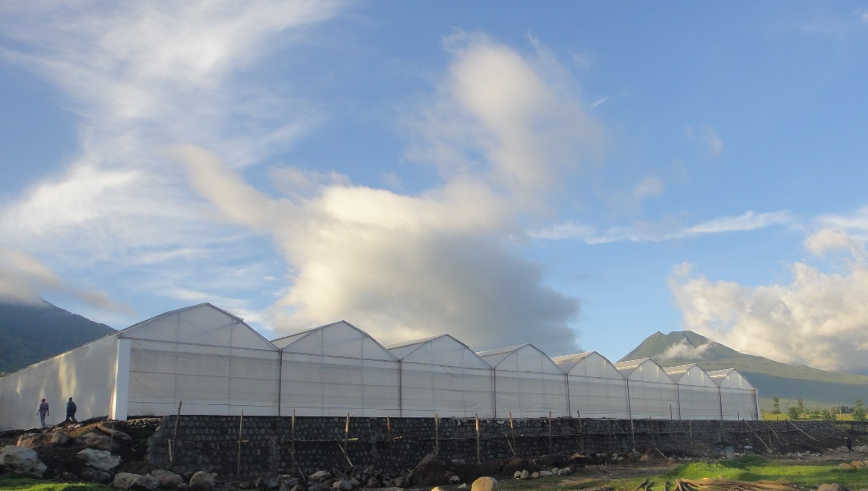
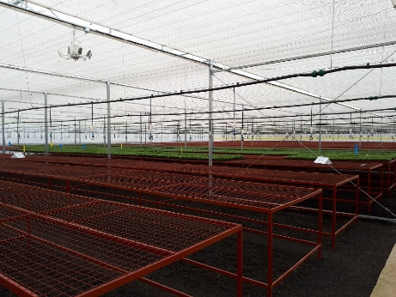
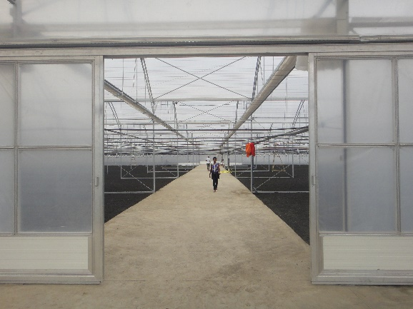
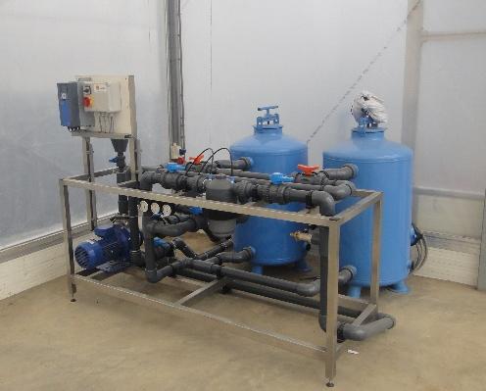
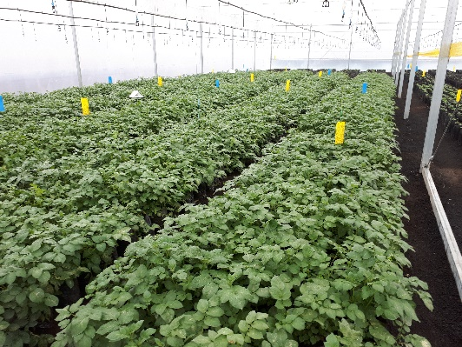
Sopyrwa Horizon, Rwanda
Propagation greenhouse project

Slide 23
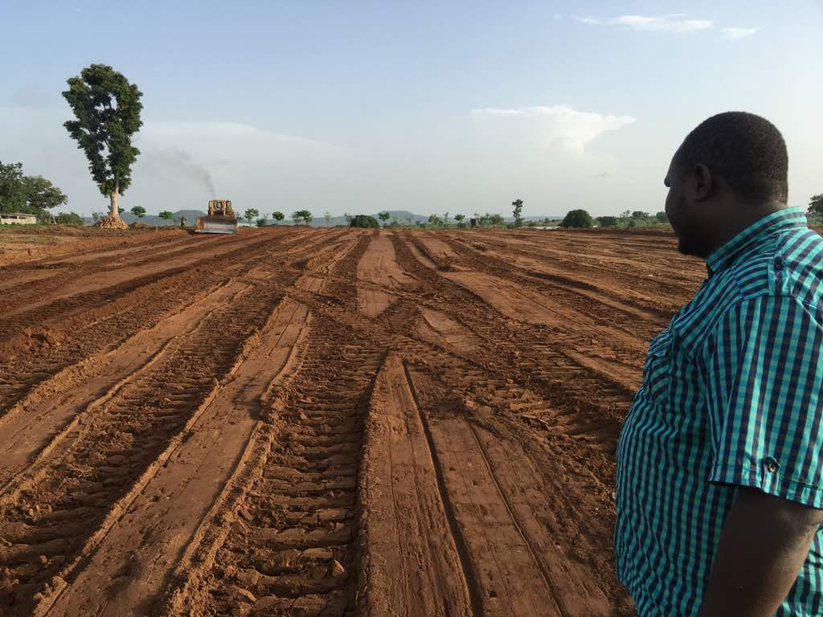
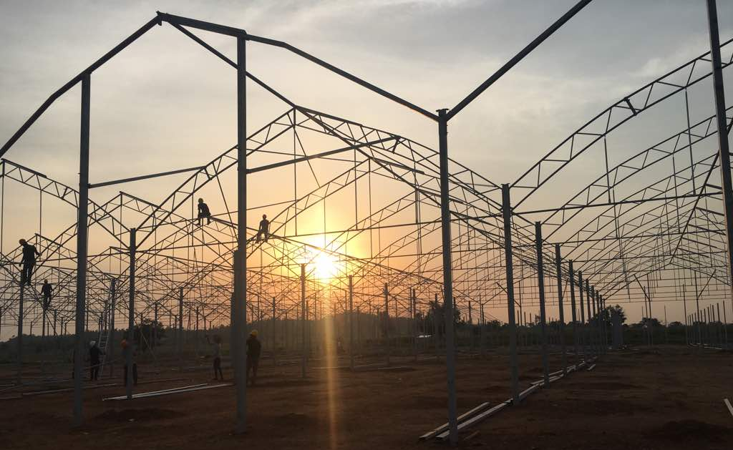
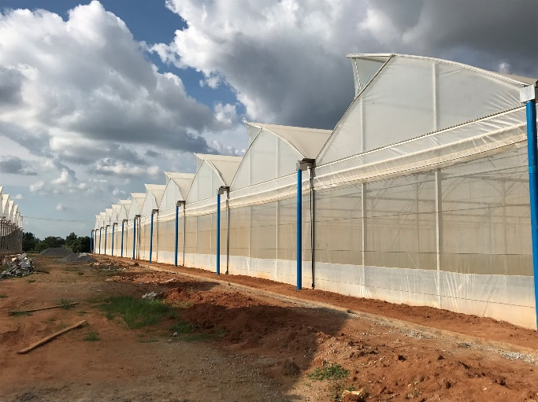
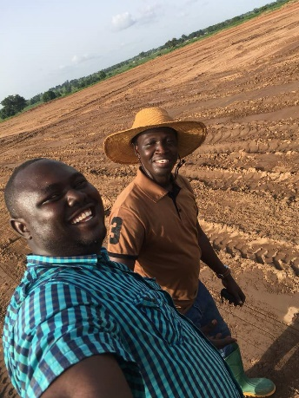
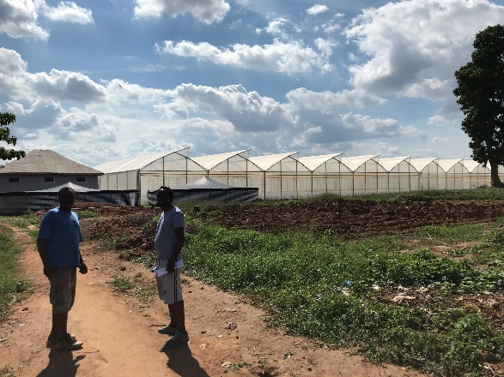
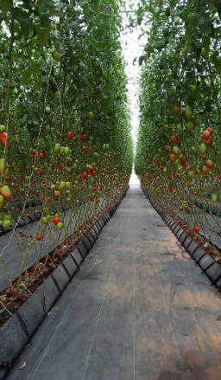
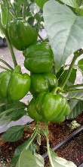
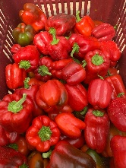


1 ha tropical lowland, high-wire vegetable greenhouse, Abuja, Nigeria
turn-key project film covered greenhouse

Slide 24






1 ha tropical lowland, high-wire vegetable greenhouse, Abuja, Nigeria
turn-key project film covered greenhouse

Slide 25





3 ha high-wire bell pepper greenhouse, Green Crisp, Namibia
turn-key project, double ridge vented film covered greenhouse

Slide 26






AOI project high-wire vegetable project, Cairo, Egypt
15.000 m² turn-key project, ½ glass – ½ film covered, Climapora (semi-closed) high-tech greenhouse

Slide 27




5 ha breeding station, Arica Chile
turn-key project, film covered greenhouses

Slide 28

Anything it takes ..
.. to realise your vision

Slide 29
Flower Business Park Panda
Naivasha, Kenya
Green Park Aalsmeer the Netherlands
Chris Alphenaar
GM Bosman van Zaal Kenya
c.alphenaar@bosmanvanzaal.com
+25 (472) 0112150
Flower Business Park- Panda
PO box 1820, naivasha, 20117
Kenya
Robert van Donk
International Business Development Manager
r.vandonk@bosmanvanzaal.com
+31 6 27000730
Braziliëlaan 4
1432 DG Aalsmeer
The Netherlands
T +31 297 344 344
www.bosmanvanzaal.com
© Bosman Van Zaal 2019

