Slide 1
Power, Water, Greenhouses
Plan For Morocco

Slide 2
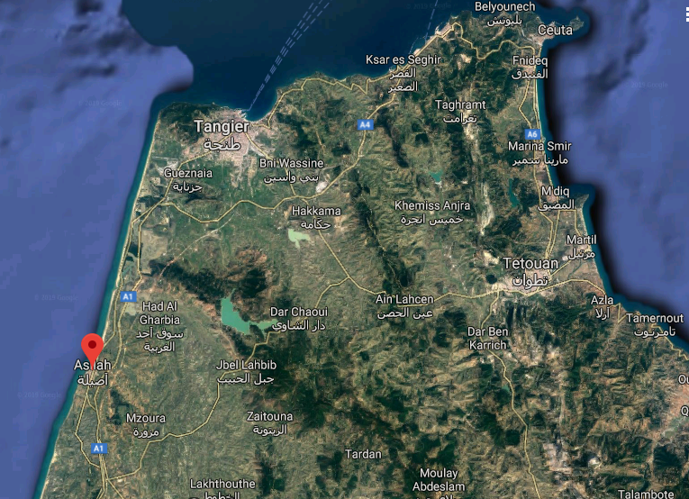

Slide 3
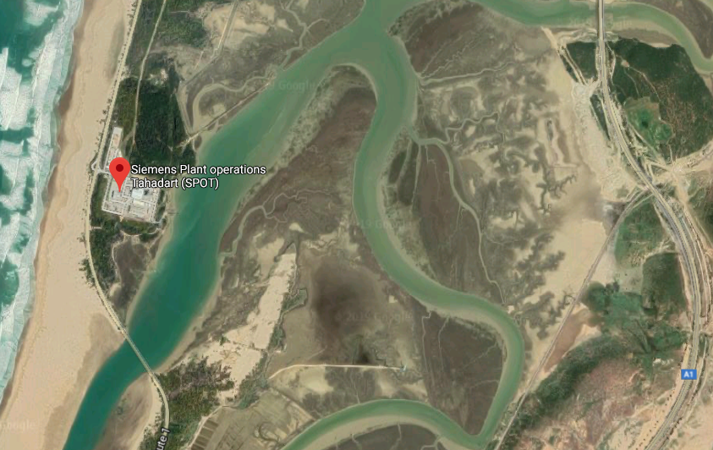
2005 – Siemens installed a SGT5-4000F gas turbine, associated steam turbine that generates 384MW(e) of power – 1+1+1 CCGT
Our objective is to purchase this facility from the government, and expand it to 4,000 MW by the addition of a series of 321MW(e) 3-1 CCGT systems.

Slide 4
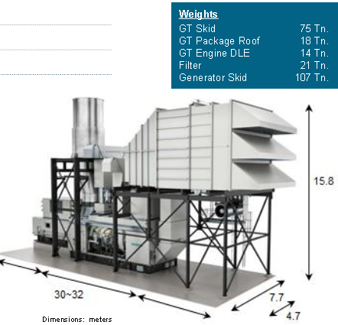
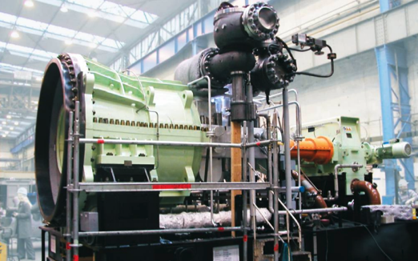

Slide 5
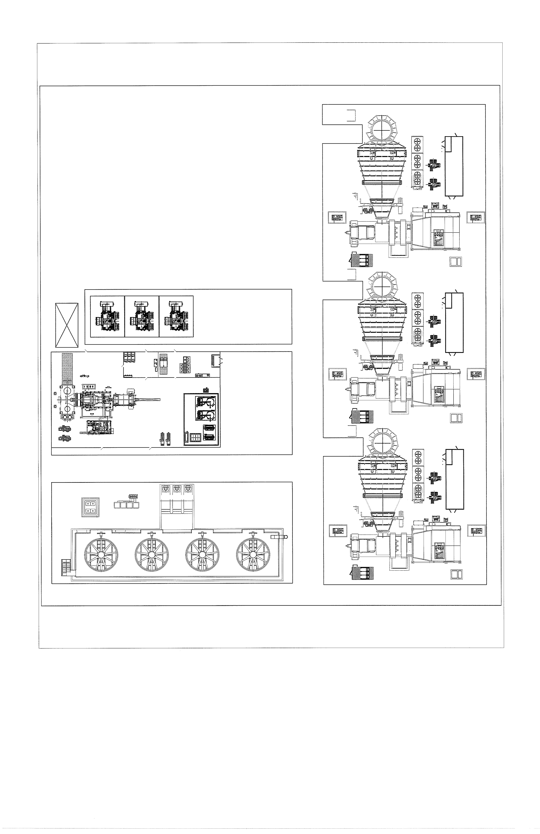

Slide 6
Ten new 3-1 CCGT systems @ 400 MW(e) each

Slide 7
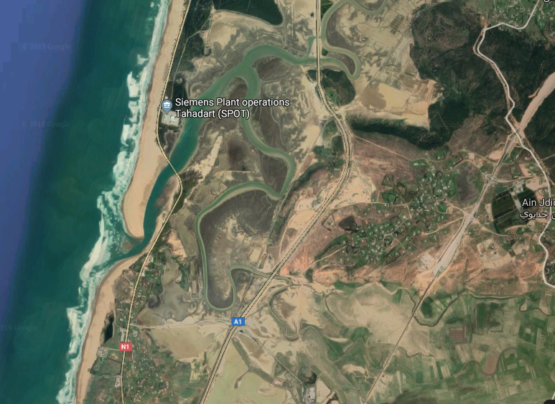
All of this water is sea water. These CCGT systems require demineralized water – 5ppm Total Dissolved Material
Each 3-1 CCGT system requires about 2,500 gallons per minute of 5ppm TDA water, 2,000 acre-feet per year.

Slide 8
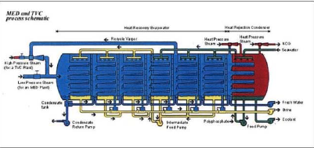
Parallel Multi-Effect Distillation units desalinate sea water. Each of these lines produce 25,000 cubic meters of 5ppm TDA water / day.
Steam condensation inside horizontal tubes and seawater evaporation on the outer side is the heart of MED. Seawater is allowed to fall down a tube bundle. Heat transfer on both sides is considered highly efficient due to the thin falling films’ low resistance. This enables efficient operation at low temperature difference across the tube walls. More stages (Effects) increase the Gain Output Ratio, the quantity of tons of water produced per ton of initial steam. MED’s Gain Output Ratio can reach 15. Under these conditions, a MED plant can be operated below 70˚ C. using aluminum tubes, achieving 50% recovery of clean water.

Slide 9
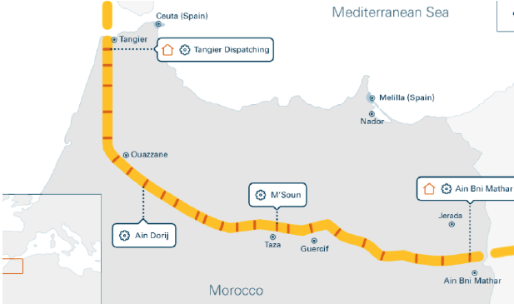
The plan is to ultimately utilize 100% of the CNG flowing through this pipeline within Morocco. The water we desalinate at Tahaddart facility (90,000 m³ X 20) will be conveyed via FRP pipes our pipeline contractors have experience with. The water will enable 3-1 CCGT wet compression systems to operate, and will enable greenhouses to grow money crops. The CNG from the pipeline will provide the CCGT fuel. The exhaust from the CCGT systems will provide CO₂ to accelerate greenhouse growth. Electricity from the CCGT systems will power the greenhouses and the local communities around which they will be built.

